Slide 1
Finding myself [outside of] college: navigating a journey between college & passion
ATIRA MEYER

Slide 2
Finding a passion
Notes:
Before College Orientation, I sat across from my mom at the kitchen island and starred the things that piqued my interest in a brochure of clubs and organizations at Nebraska Wesleyan.
I was ready for that cinematic experience of “finding myself” in college, and since I had no idea what I wanted to do or where I wanted to end up in life, I figured the first step was to get involved with everything.
Finding your passion in college isn’t just some plotline in the movies. Statistics show that college students should not only be encouraged to find their passion, or “find themselves,” in college—they should be provided the resources to do so. According to Alaina Love (2008), college students are expected to “define” the rest of their lives after just four or five years in an undergraduate program. She explained that, “coming to understand yourself and what [you are] passionate about, is the most important discovery you can make as student” (2008).
At the time I was preparing to start college, I didn’t know what I would learn about myself, but I was prepared to do anything to figure it out. But it turned out that I didn't have the experience I was expecting back then.
It’s not that the studies were wrong about the college experience. I really did find my passions while I was in college—except it didn’t happen while I was at college, and that’s a surprisingly large difference.
Over the last four years, my college education and my passion-based career path have both progressed, separately, but parallel to one another.

Slide 3
Discovery
Development
Balance
Success
Doubt

Slide 4
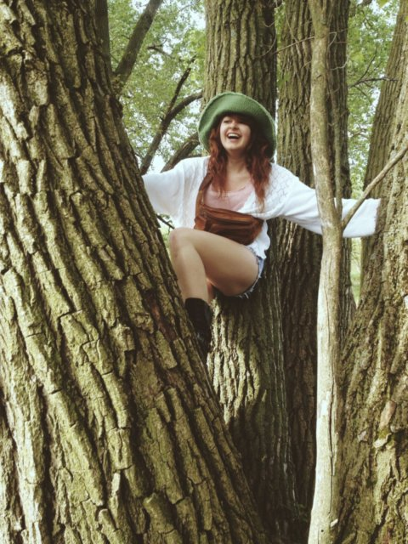
Discovery
FIRST EXPERIENCES
Notes:
Although I didn’t realize it at the time, my passion (and eventual career path) was brewing early on—before college, and before I knew what it was.
First Experiences
It started with “adventuring.” That’s what my new best friend and I liked to call our nature walks in early high school. It was on these nature walks on the outskirts of town where I discovered my love for capturing moments. I was drawn to the idea of making memories last, and she loved having her picture taken. It was the perfect match.
We were both proud new owners of iPhone 4’s, and the power I held in my hands with that iPhone made me feel like a real artist.…thus began my early connection to photography.

Slide 5
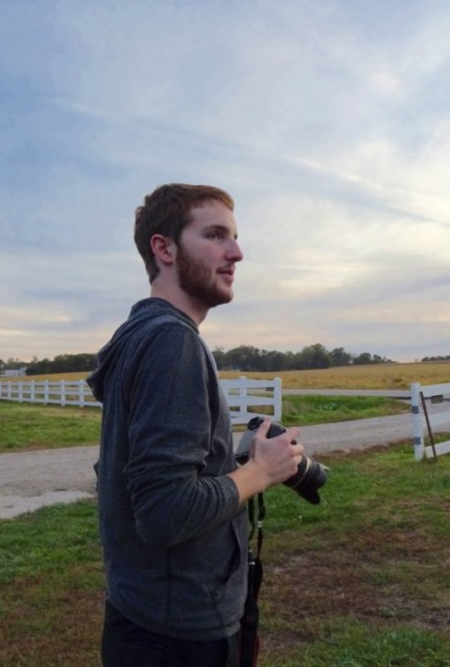
Discovery
GROWTH
Notes:
Growth
Discovering my passion only grew from there. After three years of being a “photographer” of my friends using my trusty iPhone, I met Josh. Compared to me, with my iPhone and cheesy VSCOcam filters, Josh was a real photographer. He wasn’t, actually. But he had a real DSLR camera and he knew how to use it.
Josh took my senior photos (multiple times) and as he became more familiar with portrait photography, so did I. He would bring along his old camera from when he was a kid and give me lessons on shutter speed and ISO, and when we would get back home with the photos, he’d let me sit with him at his desk and backseat-edit. I didn’t know it at the time, but that experience of looking over Josh’s shoulder and collaborating over a project—although it was not always completely civil—would reflect what a lot of our work would look like as time went on.
By the fall of my first year in college, we had actualized Josh’s photography business and had taken a few friends’ senior portraits. Nessa was often our go-to subject when we wanted to test new gear, new locations, or new ideas.
In November of 2015, the three of us went out for a photoshoot. Unsure of what to do with myself other than watch, I had a sudden moment of creative inspiration—I pulled out my phone and started taking videos of the photoshoot as it happened in front of me.
Immediately following the photoshoot, I searched for a free app for my phone that could cut and splice clips together with music and then haphazardly arranged clip after clip of Nessa tossing leaves into the air to the beat of the song. The finished product was rough, but I was proud of the result and cherished it as my first video creation. From this moment on, my passion for creating videos began to grow.

Slide 6
development
SELF-TAUGHT SKILLS
Notes:
Not long after discovering my interest in video content, the opportunities to exercise and improve those skills opened up all around me.
Self-Taught Skills
While I felt a little lost chasing after this new passion with no formal training, I doubled-down on the work to cultivate my skills. With Josh’s help, I eased my way into the technologies to get the hang of working with what “the professionals” use. I also began checking cameras out for a week at a time from Wesleyan’s library so I could take photos of my and continue practicing my skills beyond what I could learn from assisting and watching.
Before long, I was completely competent and proficient in a handful of entirely self-taught skills—skills I wasn’t learning in my classes at college.
According to Carlin Flora (2016), there is a dichotomy between the growing value of self-taught skills and the perception of self-teaching in the professional world. The value of self-taught skills is growing, as it is one gateway for people to reach new opportunities in their lives, careers, and educations, but Flora posed one question that many career-focused autodidacts still face: “Without the 'branding' of a school, how can they demonstrate their skills?"

Slide 7
development
THAT’S THE REAL EDUCATION: SEEING PEOPLE DO WHAT YOU WANT TO BE DOING, THEN
DOING IT FOR REAL.
PORTFOLIO-BUILDING
WORK
Notes:
I worried that my self-taught skills would not hold up against peers (or competitors) who developed their skills through a more formal education. Because of this fear, I doubled-down on the personal work and took any opportunity that came early on as a vital project to build my portfolio.
The work, paid or unpaid, was valuable because I was in a place where I needed to prove myself before I could move forward—a company wasn’t going to hire me for graphic design or video production as a Communication Studies major unless I could prove my worth in both.
This outlook was confirmed in a recent interview with Adam Lisagor: actor, producer, and founder of Sandwich Video Inc. in Los Angeles. [email]
His advice was clear and simple: get out there and start doing it for real. The “it” doesn’t matter, in his mind—whatever it is you’re passionate about, whatever you’re trying to get better at, that’s what you should be actively pursuing. The hands-on experience with a skill or a line of work is what he believes to be the most valuable thing for young people to obtain.
“That’s the real education,” He told me. “Seeing people who do what you want to be doing, [then] doing it for real, for a living.”
I had already been doing this for years by the time he told me, but the advice still resonated. It was a confirmation that what I had been doing so far—no matter how stressful, how tiring, how hard it was sometimes—it was the right thing to do.

Slide 8
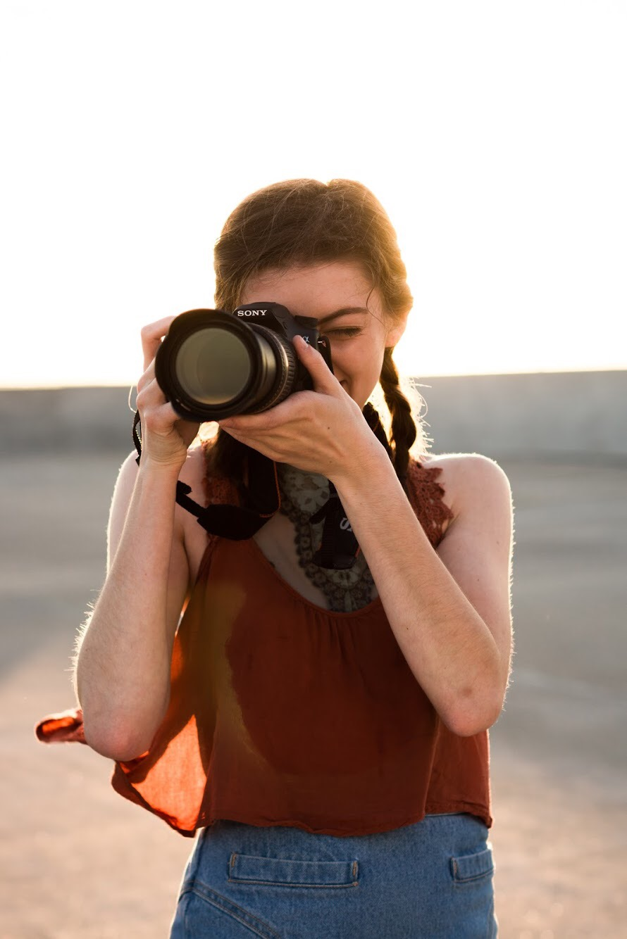
balance
PASSION VS EDUCATION
Notes:
By the time I was a Sophomore in college, I had reached a total of three jobs that were occurring simultaneously with my 16-to-18-credit-hour schedules.
At that point, I was officially getting “too busy” for college.
Perhaps it was the stress, but I also felt very strongly that I no longer wanted to be in college. I was experiencing conflict between these two areas of my life: working was instrumental to my passion and my financial needs, but it interfered with my dedication to getting an education.
Unfortunately, I learned very quickly that there was no program in place at Wesleyan that aligned with what I wanted to do, and there weren’t even enough classes to build more than a minor around it. The custom study I was able to create had to be generalized to “Digital Art” as there were not enough resources to build anything specific to video.
It became very clear that this may not have been the right path for me, but it felt like it was too late to switch schools because of scholarships I accepted—and scholarships that had to be turned down—in order to go to Wesleyan.

Slide 9
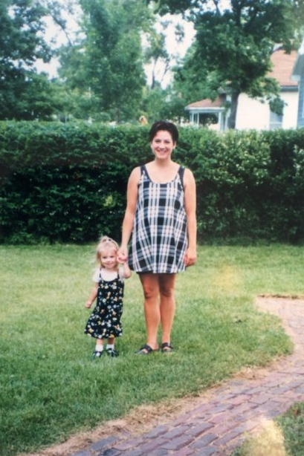
balance
VALUE OF EDUCATION
Notes:
Choosing to continue instead of quit or transfer has unfortunately been more of an obligation, rather than the holy grail of success that I once viewed it as.
Silva and Snellman (2018): working class parents of first-generation college students shape the meanings of college simply by “encourage[ing] their children to do better than they did.”
My mom attended college three times, and finally got her Associates Degree at age 37. At nine years old, I watched her stay up late and get up early to do her homework as a single mom with two kids and three jobs. She made an effort to teach me the value of education and ensured me that I’d end up like her—working low paying jobs and struggling to stay ahead—if I didn’t go to college.
Through my research, I found out that students are considered first-generation when their immediate parental figures have not completed at least a bachelor’s degree.
A lot of first-gen students go to college because they’ve been told that its the most direct path to success and financial freedom.
So, the how part of my life plan was always easy for me, even if I didn’t know what I wanted to do. I knew I had to get into college, and I had to get as many scholarships as I could in order to get there, because people like my mom didn’t get good jobs.
Additionally, the narrative of college as salvation also comes with an aspect of practicality. For me, this meant that I approached college with the perception that there was no way I could go to college and get something “useless” like an art degree.
Yet there I was, a sophomore in college, already experiencing the kind of financial and career-related success I never saw at home—and I was reaching these goals in an art-based field. I was becoming successful because of my own skills and my own hard work, not because of a college degree, and that was unexpected to say the least. Still, I found myself following through with college for the remaining two years. It was, truthfully, all I knew how to do; it had always been a vital step in my life plan.

Slide 10
doubt
IMPOSTER SYNDROME & ARTISTIC CONFLICT
Notes:
Despite experiencing success in building my career outside of college, I still had doubts. As clear as it was that I had been working hard for the achievements I was earning, I was still plagued by the feeling that I still wasn’t doing things “right,” that I wasn’t good enough, and that I was cheating my way to success. While I felt alone in these feelings, they are actually very common in young women who reach academic and career-related success (Imposter Syndrome – Clance & Imes, 1978).
Coordinated Management of Meaning (Barnett Pearce) and Attribution Theory (Heider).
Artistic Conflict: Also had some negatively affirming experiences with a former art professor here that brought me down further last year and really made me question my passion.

Slide 11
success
STABILITY
Notes:
My personal ideas of success were a constant source of motivation throughout my entire college experience, as well as my efforts to pursue my passion. Despite the doubts and the obstacles, I am very lucky to have worked hard and achieved a level of “success” that once seemed very far away.
Stability
I grew up in a family that was always just below poverty level. (Of course, I recognize that “just below” is far more privileged than many people who experience extreme poverty)
There were periods where we received government assistance, and other times where my mom just barely fell above the cutoff – and those were the times where we struggled more to get food and pay bills.
Overall, growing up in that way was a key factor in my motivation and life plans. I wanted to make sure I would never worry about finances and basic needs like I did growing up. So, to me, success is stability. And somehow, due to my own hard work and achievements, I’ve reached stability.

Slide 12
success
HAPPINESS
Notes:
There were milestones in my search for success and stability: college degree, job(s), savings, support system, staying ahead of debt, and, of course, making good choices. Even in the face of stress, those things kept me constantly motivated—and they still do.
But as I’ve developed career-related skills on my own outside of my college education, I’ve found that success also looks a little like happiness, and I have found that I have that in certain areas of my work.
Growing up, I looked at success so objectively and defined it with strict, clear conditions based on my experience—and loving my work was never on the list. I never knew that it could be. Today, it’s not only on the list, but it has been checked off by many of the projects I am involved in on a regular basis… and it is clear that I will continue to find it, as long as I continue to chase my passion.

Slide 13
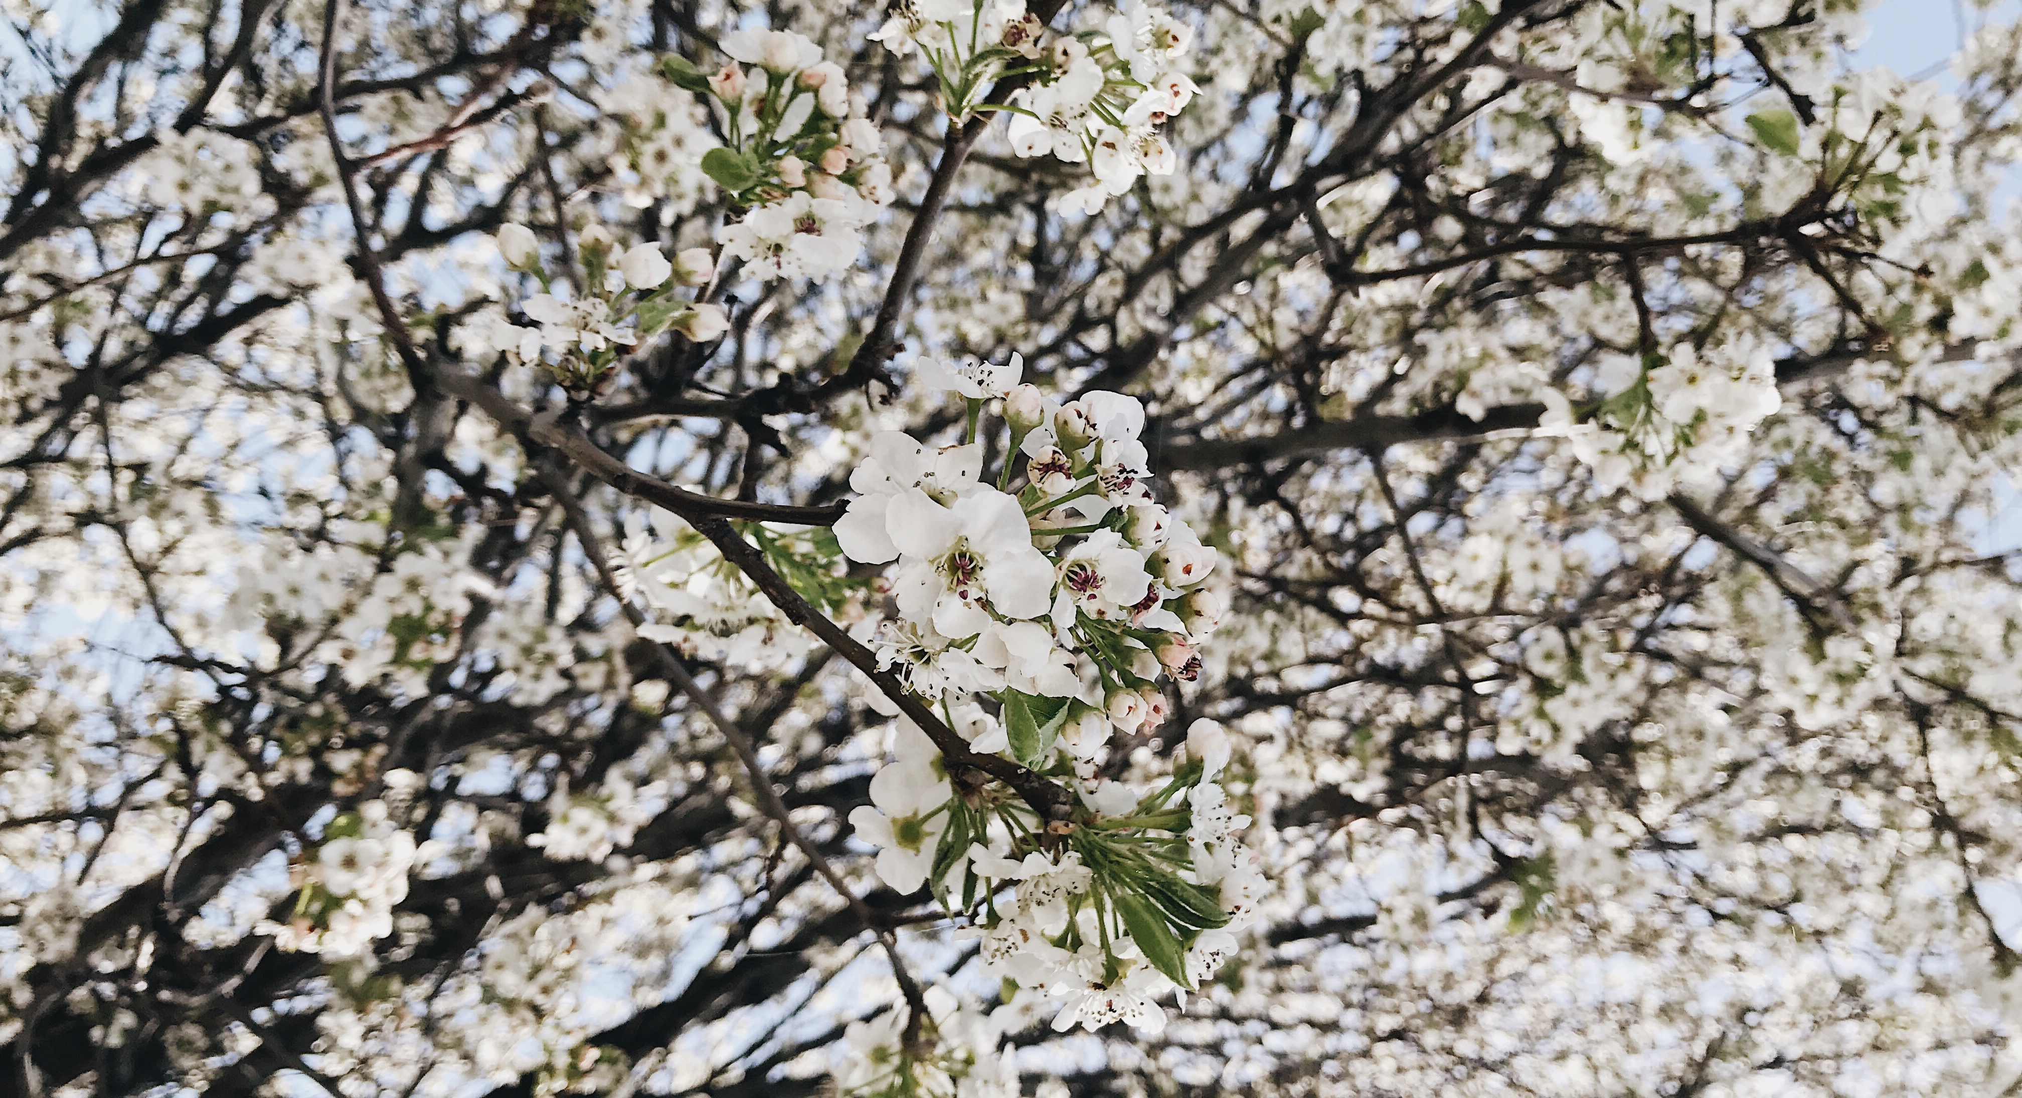
HAPPINESS
Notes:
Although this journey looks nothing like I thought it would, and has taken me down a path I would have never considered before, it is clear that I’m doing what I’m supposed to be doing. Even the hardest moments in this journey are a reminder that things are going incredibly well in a life I worked very hard for—I’m growing from where I started.

